Slide 1

FudgeWorld
IST722 | Jake Conard & Meichan Huang

Slide 2

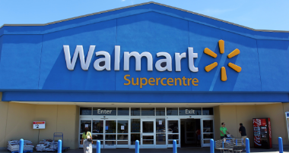
Fudgeworld - Background
In 2023 Fudgemart and Fudgeflix merged into a company called Fudgeworld.
Fudgemart was a retail store that sells different products from their stores.
Fudgeflix is a company that allows for DVD rentals and also offers some streaming services as well.

Slide 3
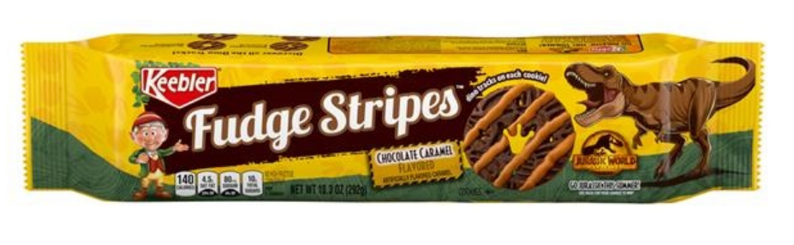
Fudgeworld – Data Warehouse
Both Fudgemart and Fudgeflix had relational databases before the merger and both companies made a large investment in data and data analysis.
With the new merger management decided that a merged data warehouse was needed to allow data analysis from both companies as well as historical data from prior to the merger.
Management wants the ability to do analysis of Fudgeworld sales while also being able to drill down into the specifics of which business line is contributing to those sales (i.e. fudgemart or fudgeflix)

Slide 4

FudgeWorld – High Level Dimensional Model
Fact Sales
Customer Dimension
Product Dimension
Date Dimension

Slide 5
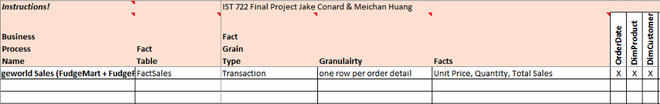
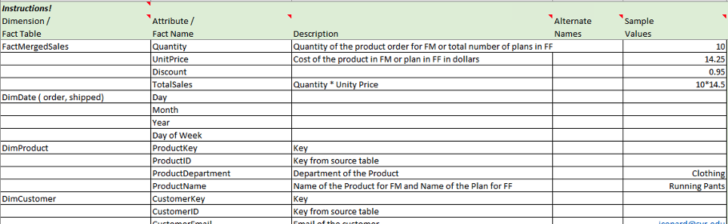
FudgeWorld – High Dimensional Model

Slide 6
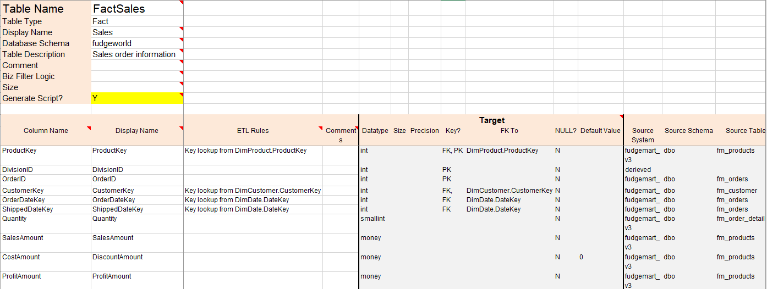
FudgeWorld – Detailed Dimensional Model

Slide 7
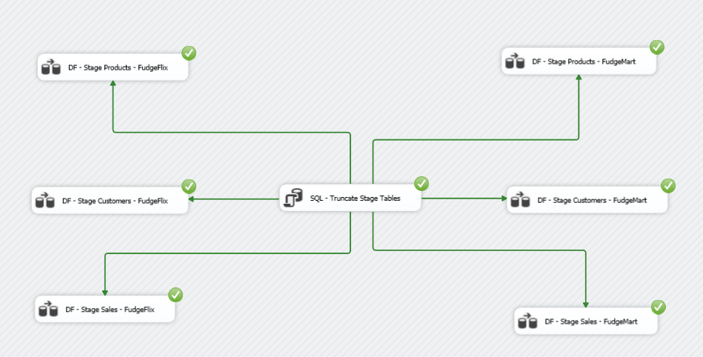
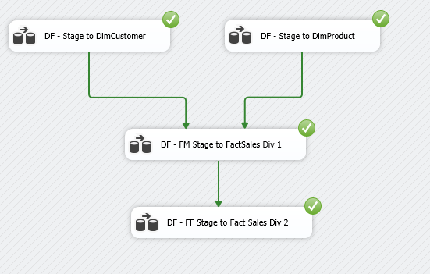
Fudgeworld Data Warehouse - ETL
We utilized Extract, Transform, Load (ETL) to move and transform the data from the original database to a stage database and then finally into the Fudgeworld Data Warehouse.
ETL was complicated because we were creating a data warehouse from two merged companies and data formatting was a problem.

Slide 8
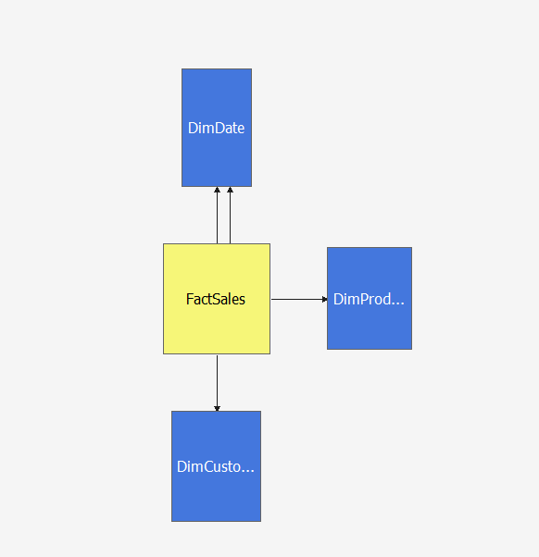
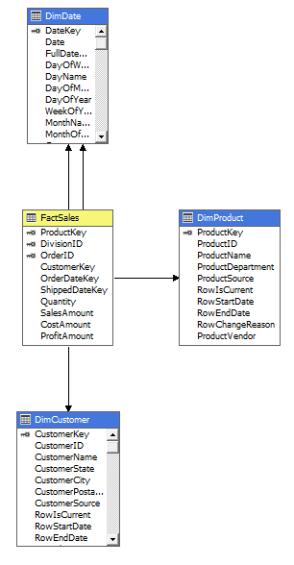
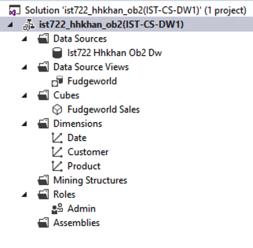
Fudgeworld – MOLAP Cube | Star Schema

Slide 9

FudgeWorld – Key Sales Questions
What was the most profitable year, quarter, and month for Fudgeworld (fudgemart & fudgeflix respectively)?
What are the most profitable departments in the Fudgeworld?
Which state(s) have the highest sales by year?
What are our top cities in terms of revenue and profitability?

Slide 10
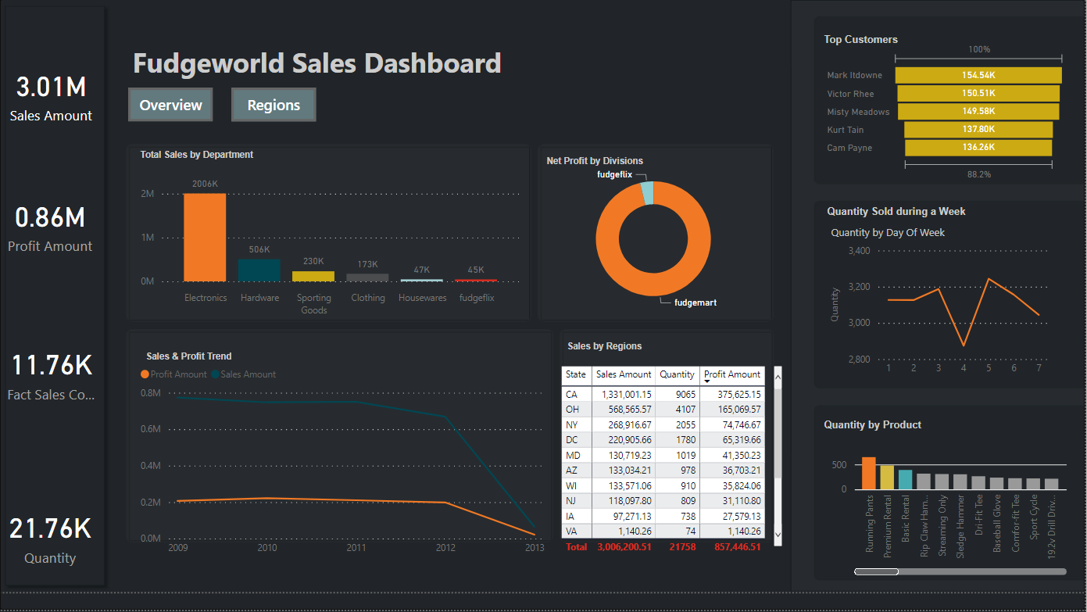
FudgeWorld – Sales by Year

Slide 11
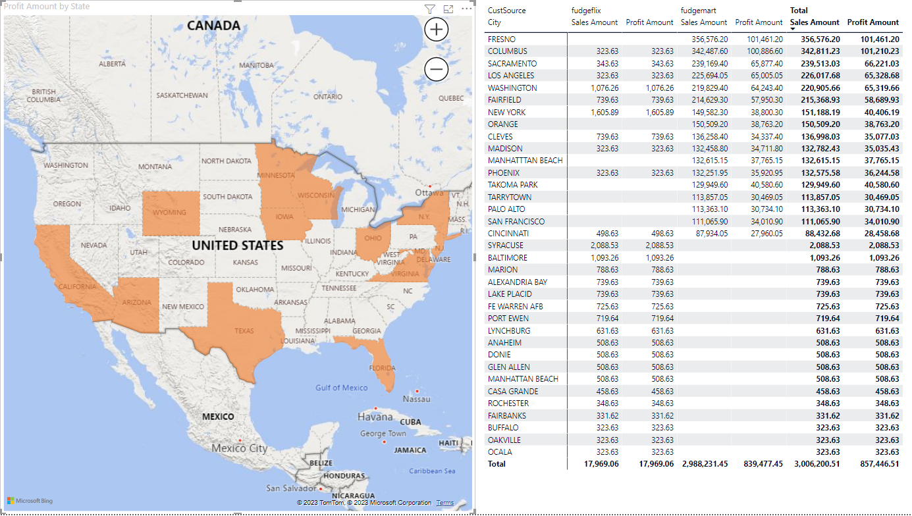

Slide 12
Issues / Improvements
Design for Fudgeflix input was not perfect. If we had more time would like to fix this to allow for more insight into FudgeFlix sales.
Ran into some issues with the upper and lower casing of City Names in FudgeMart and FudgeFlix data.
ETL process was very challenging and took a majority of the time.

Slide 13

Questions?

